Slide 1
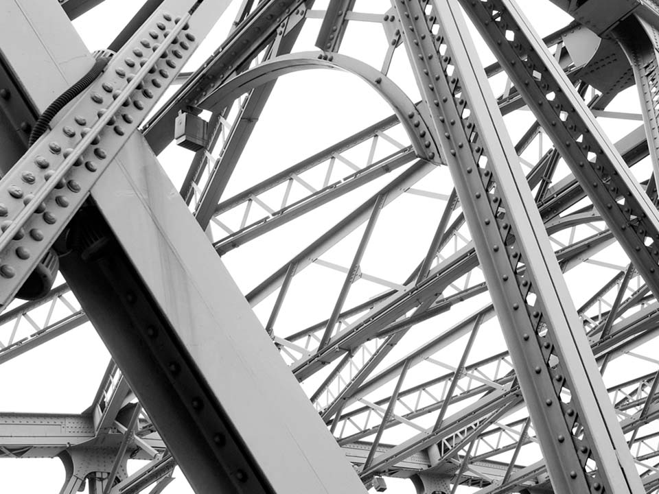

Steel Slag Business Plan –
A Case of Success in Brazil
Pedro Henrique Andrade Borges
ArcelorMittal Long Carbon Brazil -
Corporate Office
6th Slag Valorisation Symposium
Mechelen - Belgium
3 April 2019

Slide 2

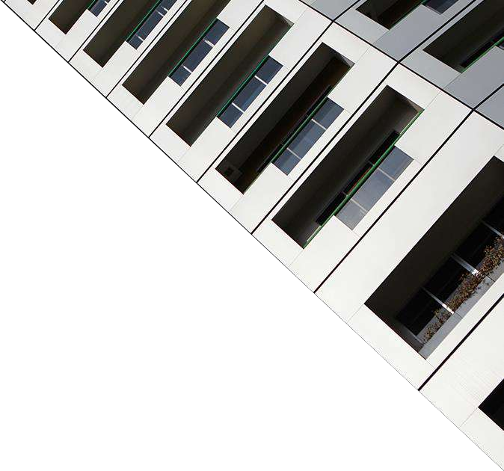
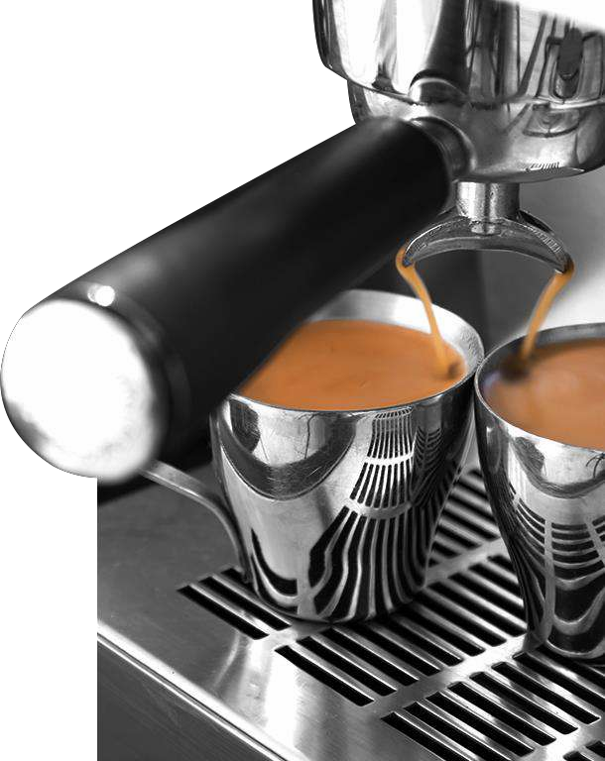
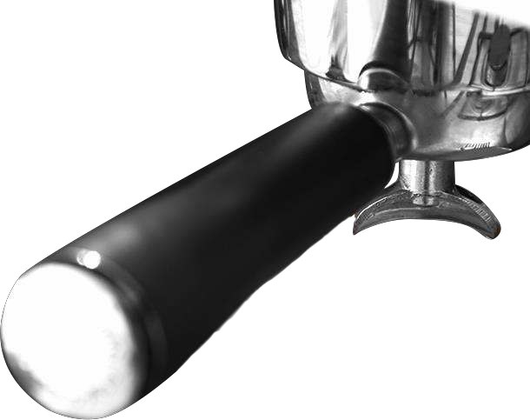
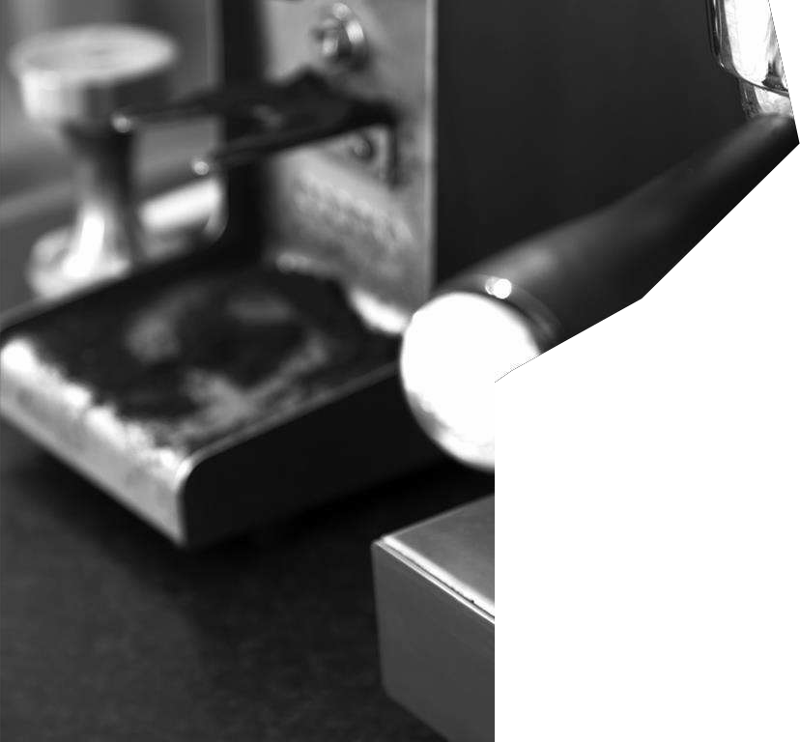
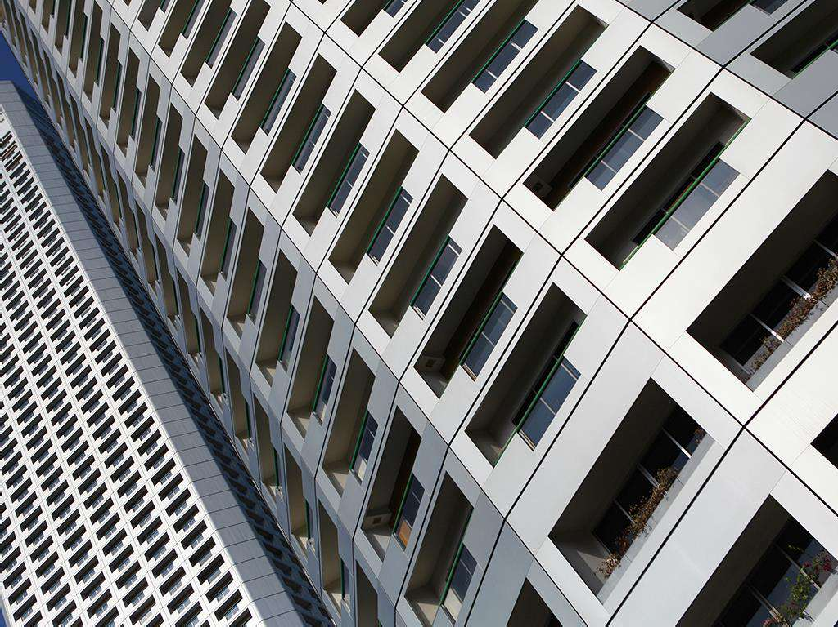
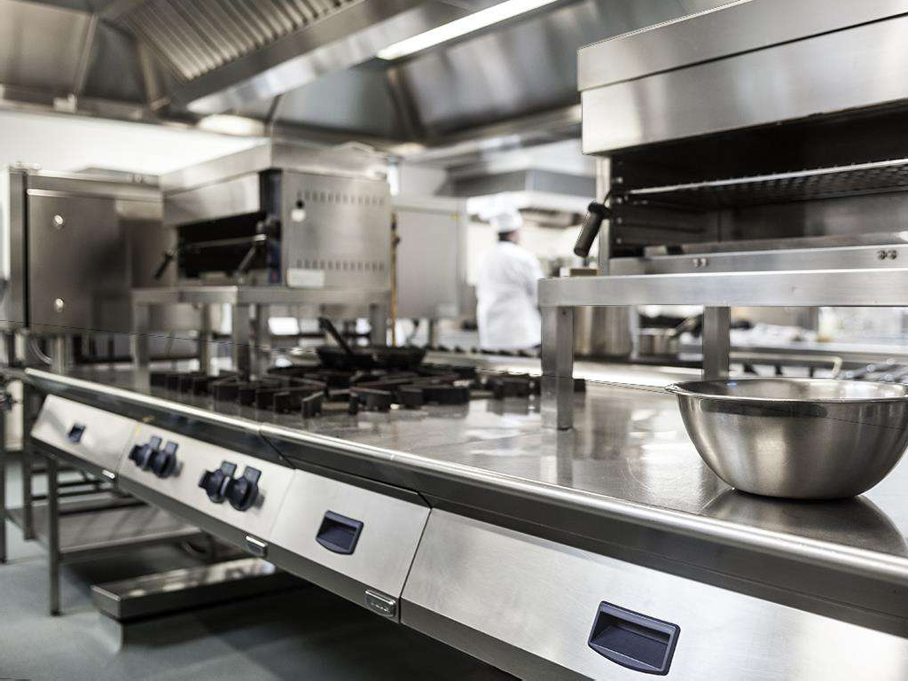
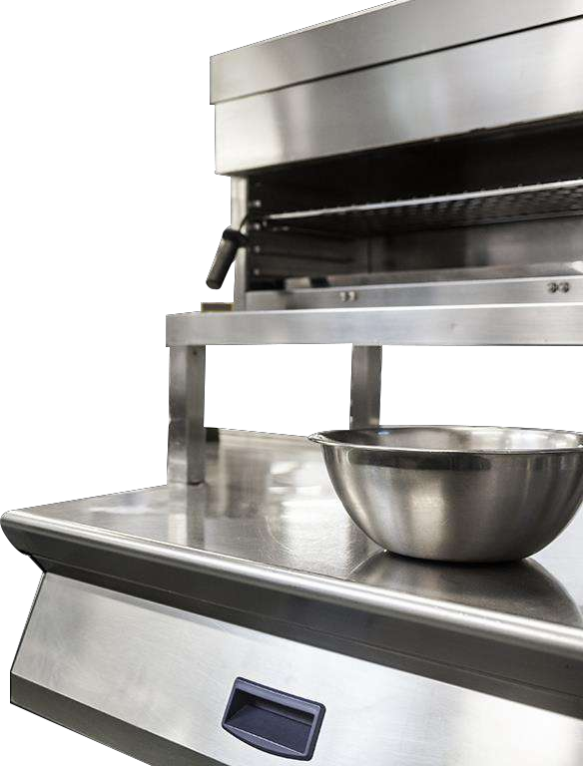







The World's Largest Steelmaker
Leader in the global steel market
Automotive
Construction
Home Appliances
Packaging
+209,000 employees
Presence in
+ 60 COUNTRIES
+ 1,300 researchers Industrial Operation in 18 countries:
47% Europe
38% Americas
15% Other countries

Slide 3
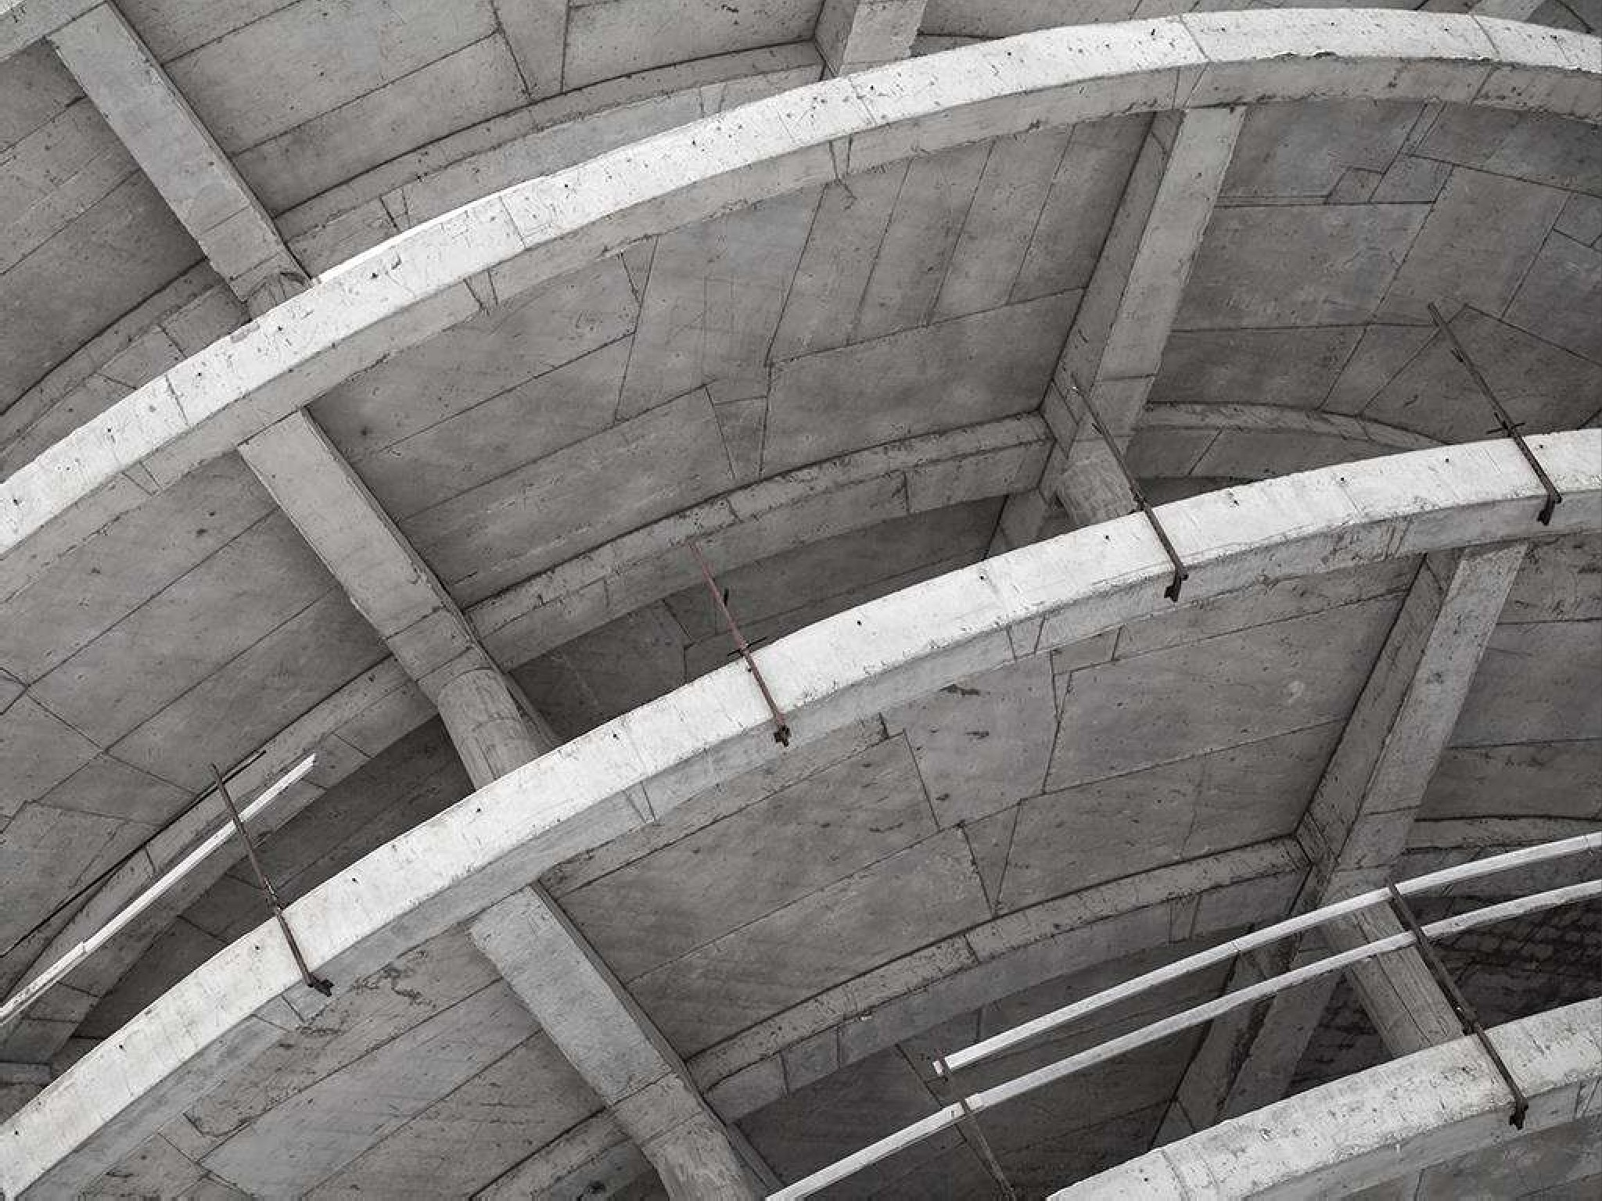






ArcelorMittal in Brazil
+30 Business Units
Annual production capacity:
12.5 mi tonnes of crude steel | 7.1 mi tonnes of iron ore
+16,000 employees
Steel
Mining
BioFlorestas - Charcoal Production
Hydroelectric Power Plant
Information Technology
ArcelorMittal Foundation – Social Projects

Slide 4
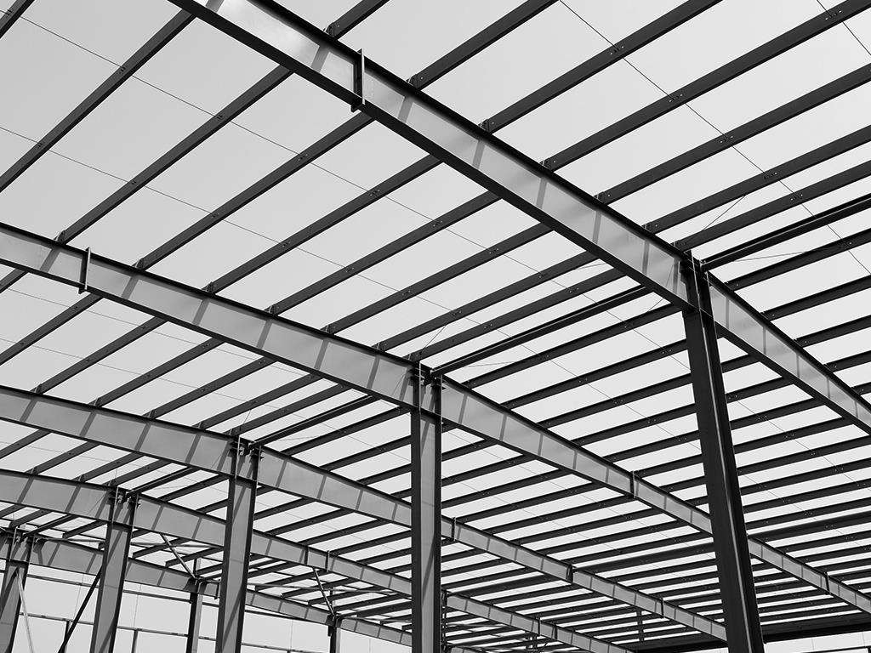


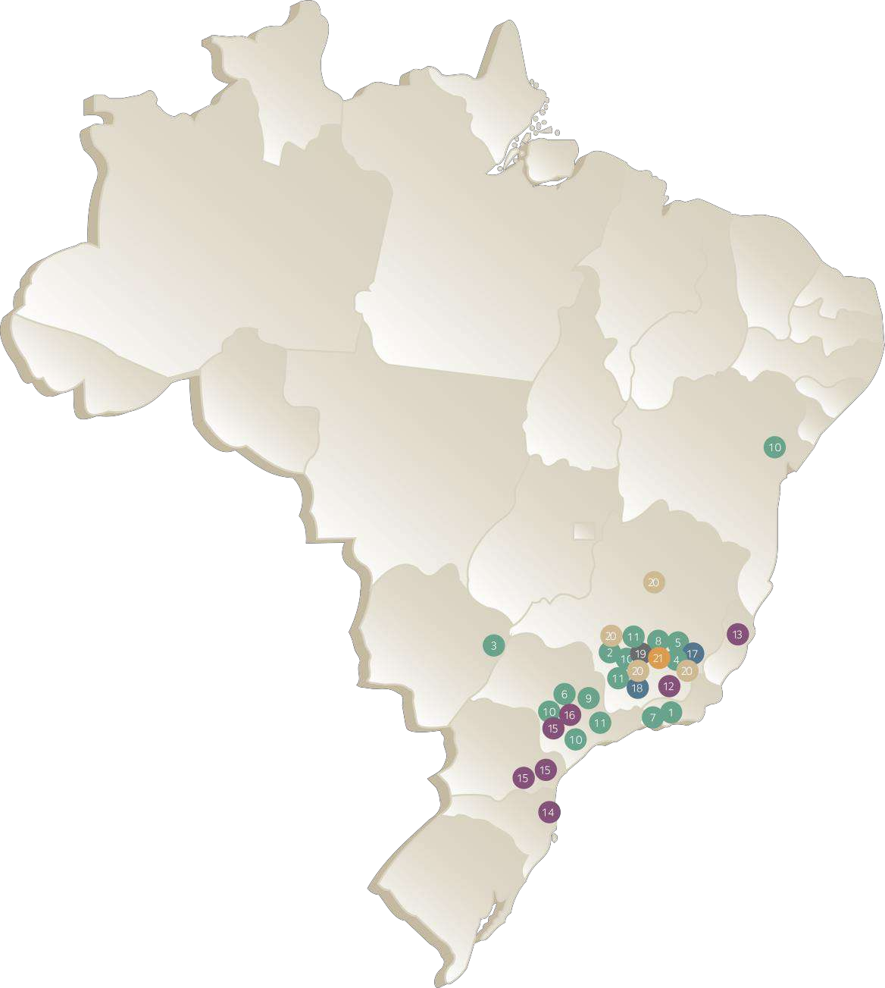







ArcelorMittal Brazil
ArcelorMittal Piracicaba
1 ArcelorMittal Barra Mansa (RJ)
ArcelorMittal Divinópolis (MG)
ArcelorMittal Sitrel (MS)
ArcelorMittal Juiz de Fora (MG)
ArcelorMittal Monlevade (MG)
ArcelorMittal Piracicaba (SP)
ArcelorMittal Resende (RJ)
ArcelorMittal Sabará (MG)
ArcelorMittal São Paulo – São Paulo (SP)
Belgo Bekaert Arames (BBA) Feira de Santana (BA), Contagem e Sabará (MG), Osasco e Hortolândia (SP)
Belgo-Mineira Bekaert Artefatos de Arame (BMB), Itaúna e Vespasiano (MG) e Sumaré (SP)
MINERAÇÃO
17 Mina do Andrade - Bela Vista de Minas (MG)
18 Mina de Serra Azul - Itatiaiuçu (MG)
RESPONSABILIDADE SOCIAL
19 Fundação ArcelorMittal Brasil
Belo Horizonte (MG) e mais 40 municípios
BIOFLORESTAS
AÇOS PLANOS
ArcelorMittal Bioflorestas
20 Belo Horizonte, Carbonita,
Dionísio e Martinho Campos (MG)
ArcelorMittal Contagem (MG)
ArcelorMittal Tubarão - Serra (ES)
ArcelorMittal Vega - São Francisco do Sul (SC)
ArcelorMittal Gonvarri – Campinas e Hortolândia (SP), Araucária e Curitiba (PR)
ArcelorMittal Perfilor - São Paulo (SP)
TECNOLOGIA DA INFORMAÇÃO
21 ArcelorMittal Sistemas - Belo Horizonte (MG)

Slide 5
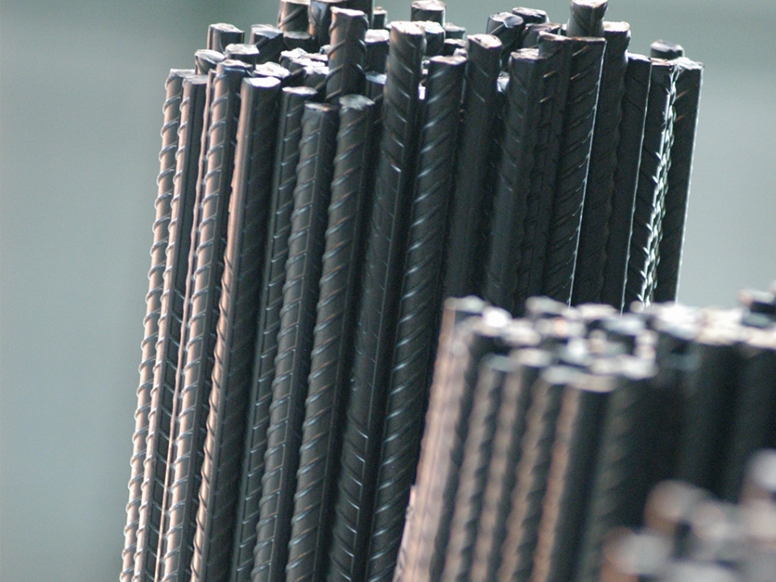
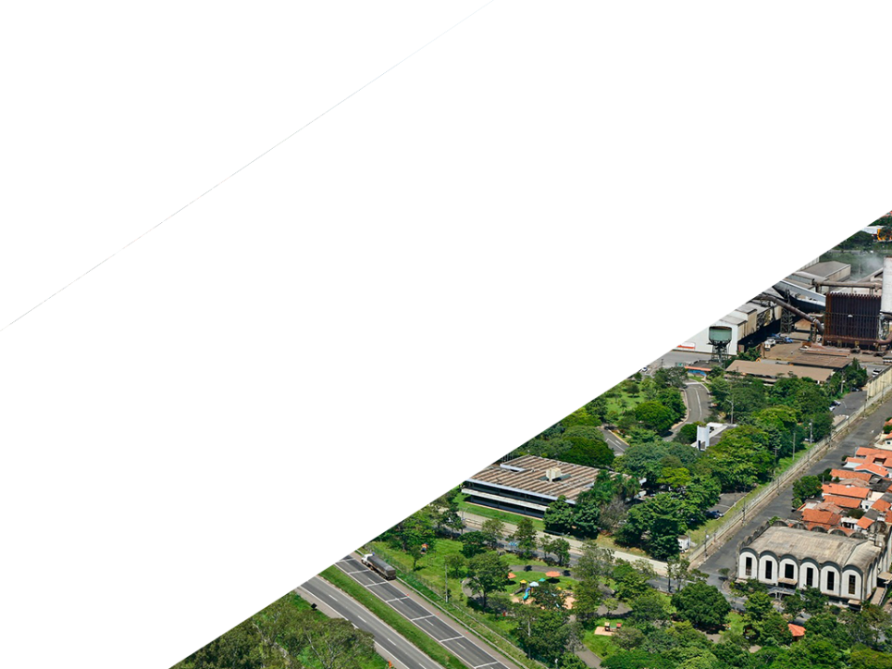
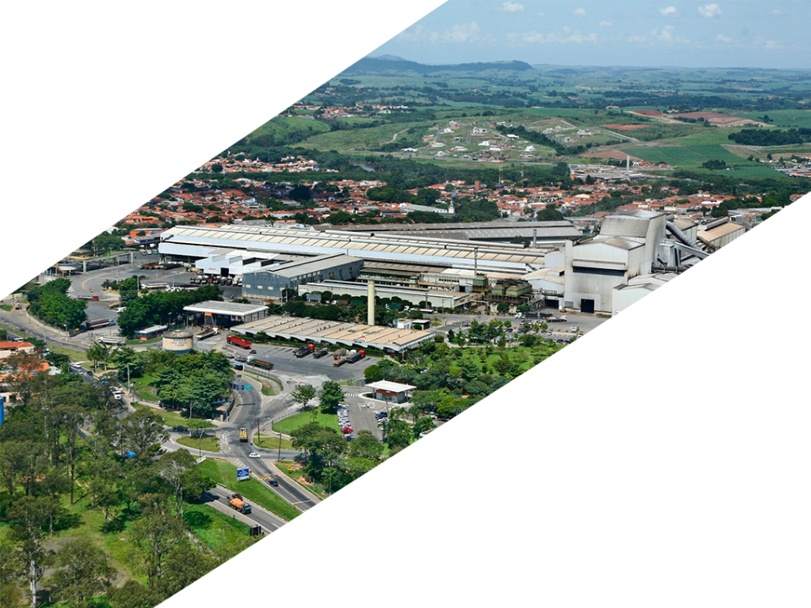
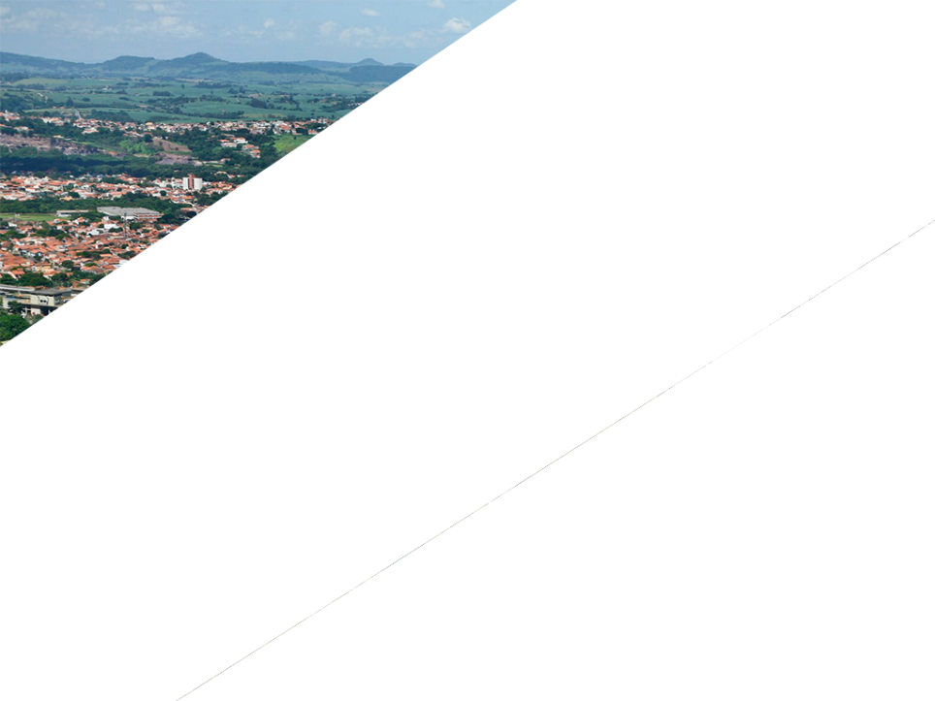



ArcelorMittal Piracicaba
Currently, it’s the largest semi-integrated mill in the state of São Paulo, with a capacity of 1 million tons/year of crude steel production and 353 employees.
Electric Arc Furnace (EAF) Slag is the main residue generated, representing around 110 kg per tonne of crude steel produced at the plant.

Slide 6


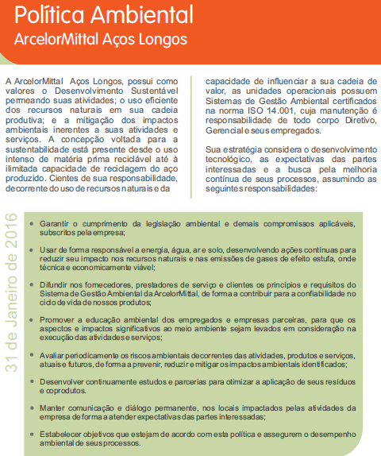
Motivations
Strategic Policy of the Company
Among the several principles, values ​​and responsibilities of ArcelorMittal Long Carbon Brazil that are focused on Environment and Sustainability, we highlight the following:
To continuously develop studies and partnerships to optimize the application of waste and by-products.
Notes:
5

Slide 7
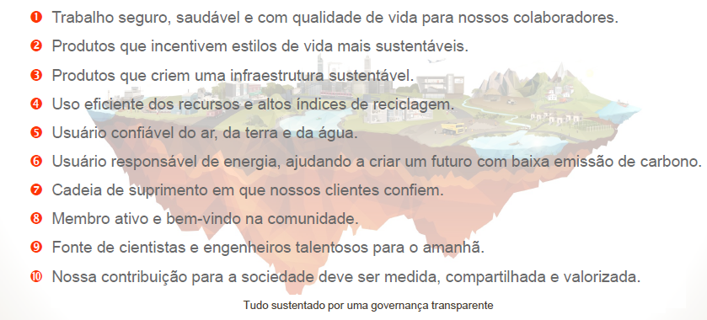
Motivations
10 Guidelines of Sustainable Development
ArcelorMittal Brazil remains in line with its corporate guidelines that outlined a new approach to the sustainability of the ArcelorMittal Group since 2014 – Three of them are aligned to the use of by-products.
Notes:
6

Slide 8
Motivations
Principles of By-products Management
Sustainability
To reduce the use of non-renewable raw materials
To reduce waste generation
To minimize waste shipment to landfills
Market
Social Responsability
To develop new applications
To create needs
To meet the demands of local markets
BY-PRODUCTS
To stimulate changes in business, society, education and industry
Financial
Internal Processes
To reduce costs with residues destination
Obtain profit with by-products sales
To eliminate stocks
To optimize industrial processes
Notes:
7

Slide 9
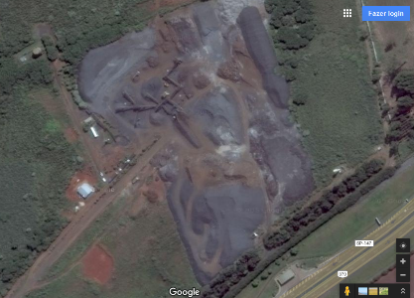
Starting Point
Increasing Stocks + Lack of Physical Space
In order to avoid the high costs involved by sending slag to landfills or with the licensing of new storage areas, studies and actions were initiated back in 2015 to solve the problem, aiming to insert the steel aggregate in the market in a more aggressive way.
Slag stocks
Notes:
8

Slide 10
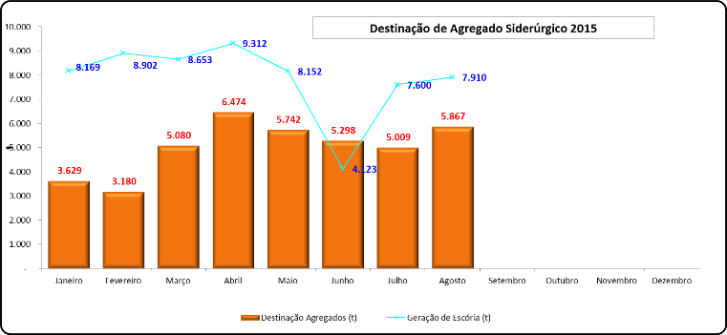
Starting Point
The Problem in Numbers
Difference between generation and destination = stock formation
Notes:
9

Slide 11

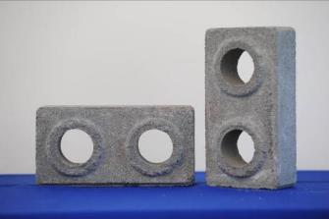
Difficulties
Despite being classified as a non-hazardous waste according to Brazilian standards, the utilization of steel slag in Brazil still represents difficulties to the industries, mainly due to restrictions and lack of positioning of the environmental agencies about the forms of its application.
In São Paulo state, for example, there are only two uses authorized by the Environmental Agency: Sub-base on roads/paving and manufacture of concrete artefacts.
Notes:
10

Slide 12
Cause Analysis
Ishikawa Diagram
Environment
Employee
Method
Limited storage space;
Environmental restrictions for the application of the Steel Aggregate in São Paulo state;
Low market demand for large Aggregates.
No professionals dedicated to the development and commercialization of by-products.
Slag Processing Plant without any plans of maintenance and cleaning;
Increasing slag stocks
Lack of marketing material;
Steel Aggregate is not attractive as a product.
Slag processing occurs according to the demand of Steel Aggregate by the market.
No up-to-date technical specifications.
Material
Machine
Measurement
Notes:
11

Slide 13
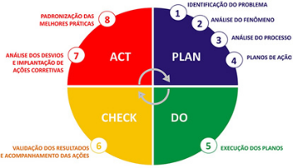
Methodology
Use of the PDCA Tool for the Project Development
Establishment of Goals
The Steel Aggregate sales should be higher than the EAF Slag generation, in order to show reduction of internal Stocks.
Notes:
12

Slide 14
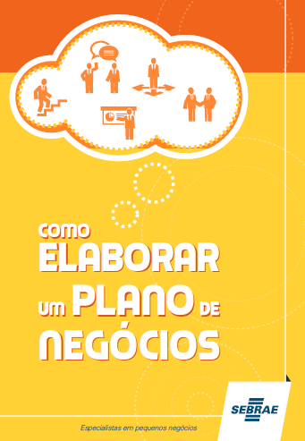
The Solution – The Business Plan
Application of a recognized methodology in an innovative way (for a By-product):
The Business Plan
The Steel Aggregate Business Plan was prepared based on the Sebrae (Brazilian Service to Support Micro and Small Companies) Guide - "How to Prepare a Business Plan" (2013).
It’s a document composed of steps that aim to help the manager to identify the best way of entering and acting in the market. By following it, it was possible to:
Carry out market analyses
Identify potential costumers
Identify competitors
Establish prices
Create operational, financial and marketing plans
Notes:
13

Slide 15
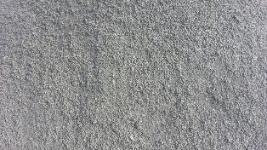
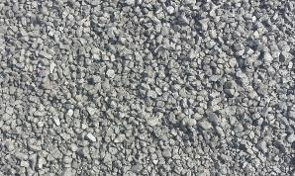
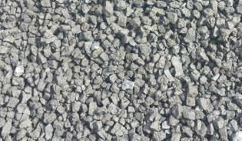
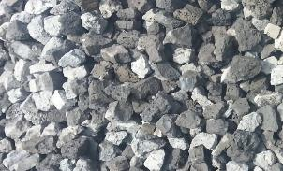
Business Plan Development
Technical adequacy of the Steel Aggregate to the same commercial characteristics of the natural aggregates, treating it, in fact, as a product.
Granulometric adjustments (acquisition and installation of new sieves for the slag plant)
Separation of the EAF slag of any other residues (like ladle furnace slag).
0” a 3/16” (0 a 4,75 mm)
3/16” a 3/8” (4,75 a 9,51 mm)
3/8” a 3/4” (9,51 mm a 19 mm)
3/4” a 2” (19 a 50,8 mm)
Notes:
14

Slide 16

Business Plan Development
Update of technical specifications to meet Brazilian requirements:
ABNT NBR 16.364/2015
DNIT 406/2017 - ES - Granulometrically stabilized base with Açobrita®
DNIT 407/2017 - ES - Granulometrically stabilized sub-base with Açobrita®
Study of Competitors
18 quarry companies located near Piracicaba.
Feasibility Study
Viable up to a 40 km radius from the generation point, considering a safety margin that includes toll costs, variations of budgets of other carriers and competitive price variations.
Notes:
15

Slide 17
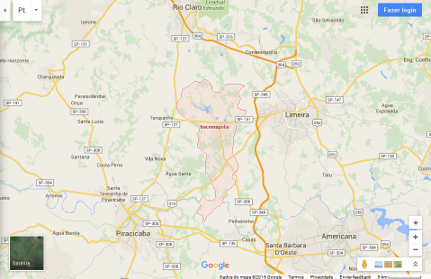
Business Plan Development
Market Study
Market research considered cities with more than 150 thousand inhabitants and within a 40 km radius from the production site of the Steel Aggregate, according to a regional feasibility study.
Potential Clients in the Region Studied:
12 Customers
Consumption potential:
9,465 t/month*
Pátio de Iracemápolis
* Considering the formula used by one of the clients (300 kg of steel aggregate per m³ of concrete)
Notes:
16

Slide 18
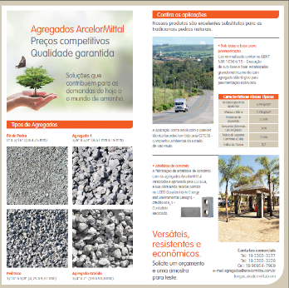
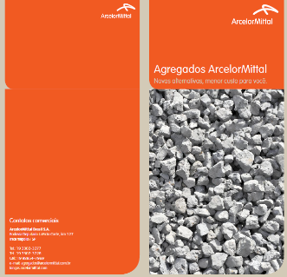
Business Plan Development
Creation of a flyer for the Steel Aggregate
Distribution to potential clients in company visits, conferences, events, universities, etc.
Notes:
17

Slide 19
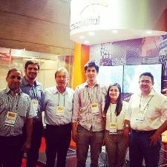
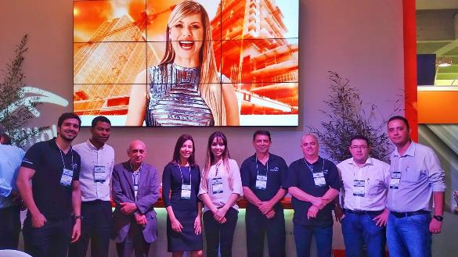
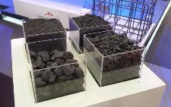
Values Created by the Project – New Partnerships
Never-seen-before synergy in ArcelorMittal Brazil between the Environmental and Commercial and areas, sharing experiences and contacts with current and potential steel customers.
Notes:
18

Slide 20
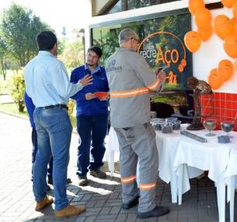
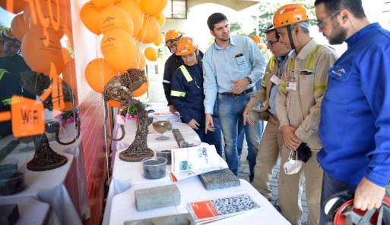
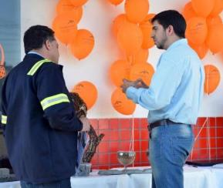
Values Created by the Project – Training and Awareness
Development of employees' environmental awareness regarding the importance of an adequate waste management, classifying them as By-products.
Notes:
19

Slide 21
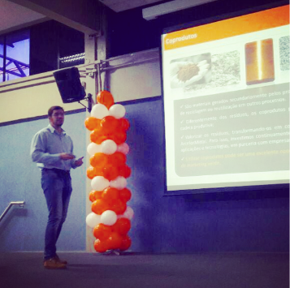
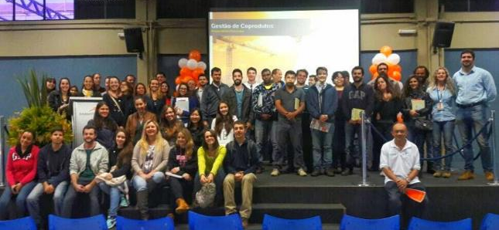
Values Created by the Project – Recognition by Society
Dissemination of best practices and cases of success of ArcelorMittal to the society.
Notes:
20

Slide 22
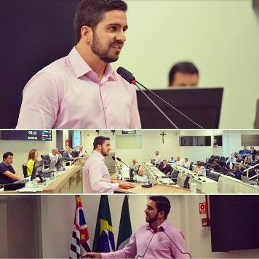
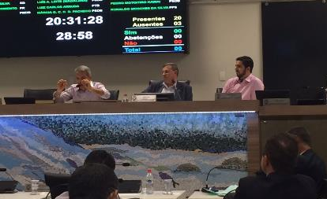
Values Created by the Project – Networking
Innovative discussions in Brazil on the agenda of the City Council of Piracicaba about new legislation to encourage the use of recycled products in the municipality's works, among which, the Steel Aggregate applies.
Notes:
21

Slide 23
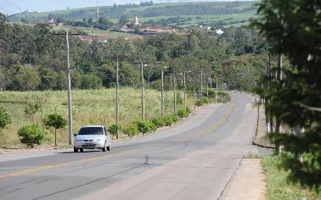
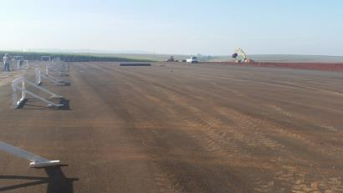
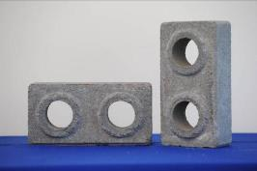
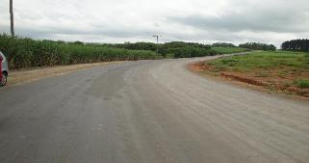
Values Created by the Project – Costumers Satisfaction
Guarantee of customers satisfaction in the field of paving and manufacture of concrete artifacts;
Notes:
22

Slide 24
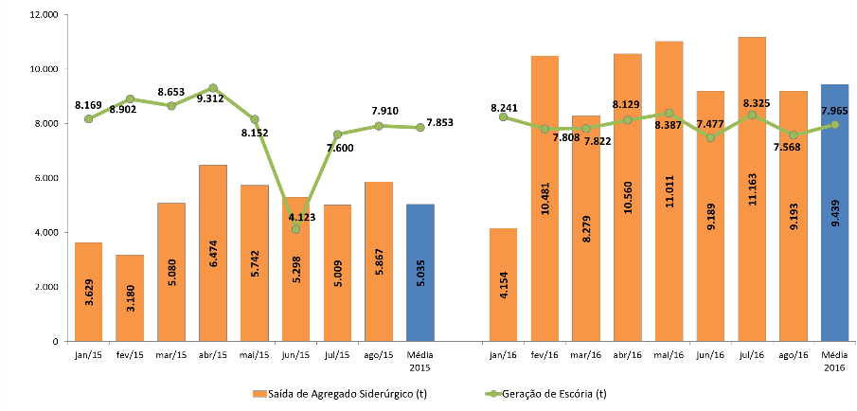
Results – Increase of Steel Aggregate Destination
2015
2016
Notes:
23

Slide 25
Financial Results
Potential savings compared to disposing slag in landfills
Potential costs with the disposal of slag in licensed industrial landfills = MR$ 6
Steel Aggregate’s profit
Revenue generated with Steel Aggregate Sales in a year = KR$ 250
Total Financial Gains
= MR$ 6,25 (US$ 1,60)
Notes:
24

Slide 26

Current Situation
ArcelorMittal Piracicaba’s Steel Aggregate is now considered the best of all LC units, in terms of quality. Besides its controlled expansion, it meets all other requirements of the technical standards of DNIT and ABNT, for use in paving.
ArcelorMittal Piracicaba’s Steel Aggregate is the only one currently being sold to the concrete artifacts market in Brazil, authorized by the state’s environmental agency.
The Steel Aggregate sales currently generates an average revenue of U$ 50/year for ArcelorMittal Piracicaba.
Today, the plant operates processing only the EAF slag that is generated daily, with no stocks remaining.
Establishment of a new business vision for ArcelorMittal Brazil, influencing the creation of a structure dedicated to By-products in the Long Carbon sector.
Notes:
25

Slide 27
THANK YOU!
Pedro Henrique Andrade Borges
ArcelorMittal Long Carbon Brazil
+55 31 98414 7043
pedro.haborges@arcelormittal.com.br
6th Slag Valorisation Symposium
Mechelen - Belgium
3 April 2019

